Slide 1
http://gisday.rgf.rs

Slide 2
Understanding our world:
Esri i ENVI alati
Autor: MSc Vojkan Gajović, dipl. prostorni planer
vojkan.gajovic@gdi.net
RUDARSKO
GEOLOŠKI FAKULTET

Slide 3
Sadržaj:
Dinamičan svet
Esri ArcGIS
Exelis ENVI

Slide 4
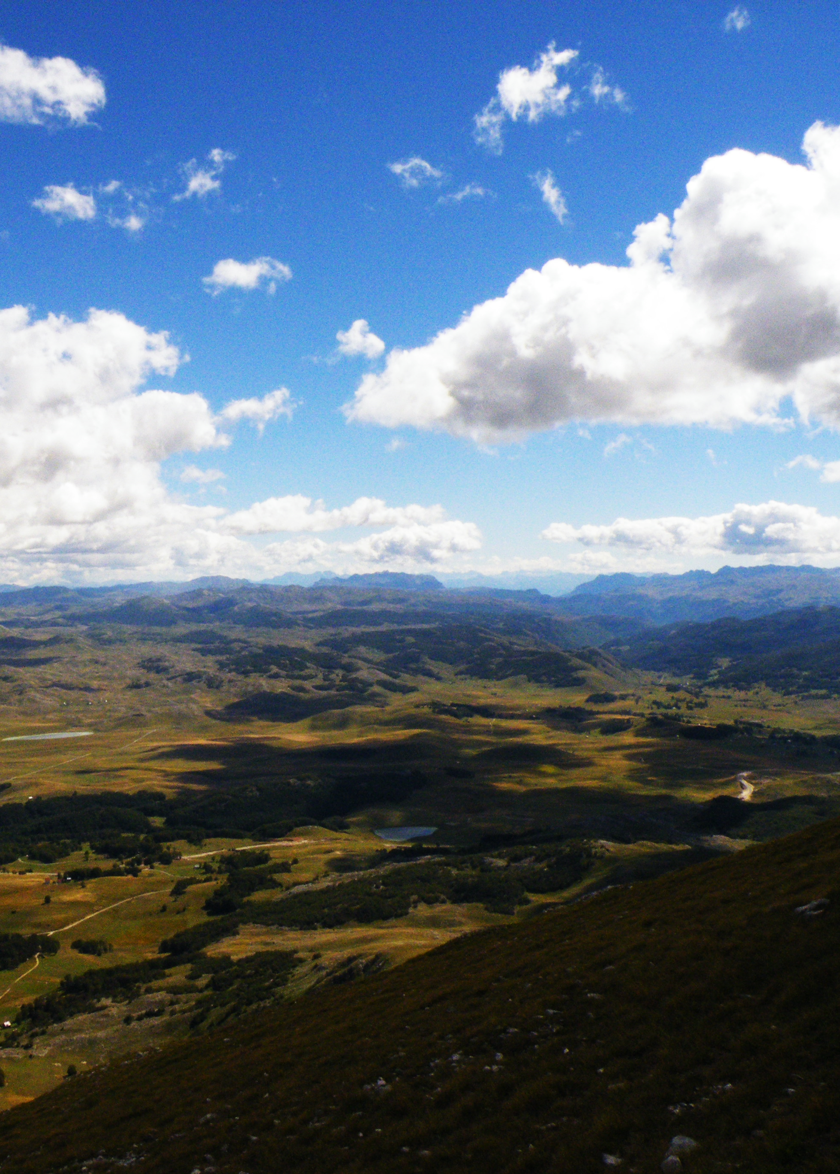
Dinamičan svet

Slide 5
Drumski saobraćaj
Beograd - Srbija, 19.11.2013.

Slide 6
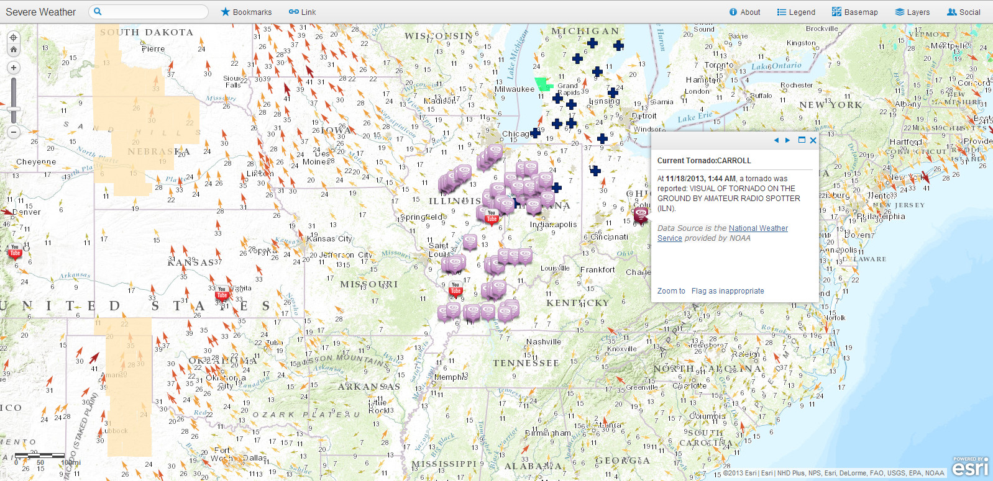
Sezona tornada
SAD, 19.11.2013.

Slide 7
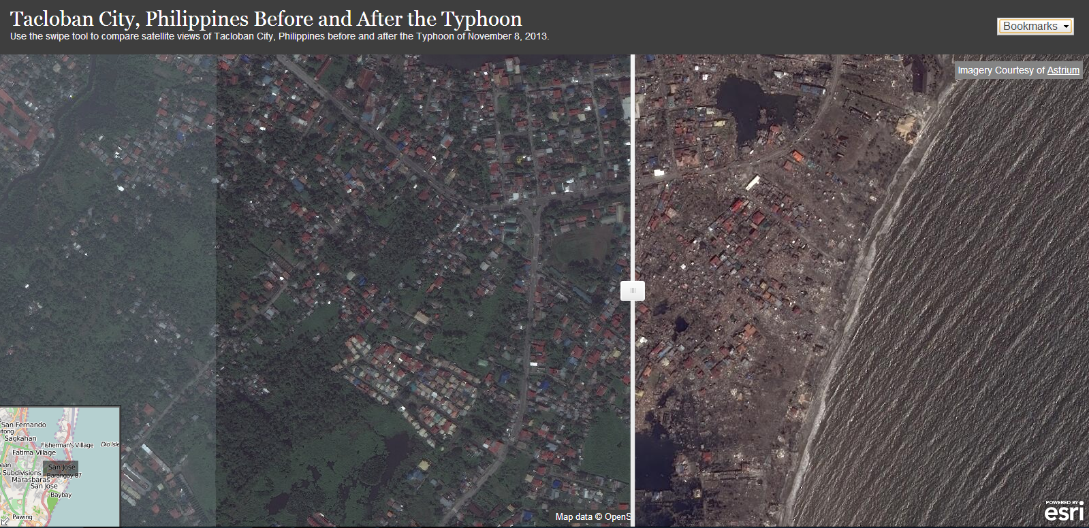
Tajfun Haiyan/Yolanda
Filipini, 08.11.2013.

Slide 8
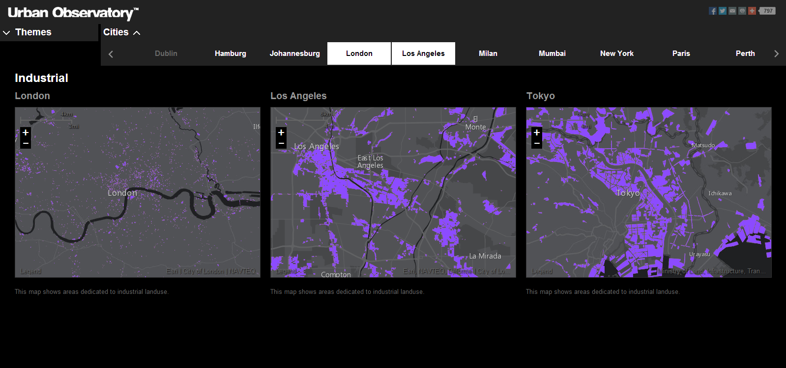
Urban Observatory
London / Los Angeles / Tokyo

Slide 9
Dinamičan svet
Dinamičan pristup
Naučni pristup
Kvalitetni podaci u realnom vremenu
Donošenje pravovremenih odluka
Prevencija i delovanje

Slide 10
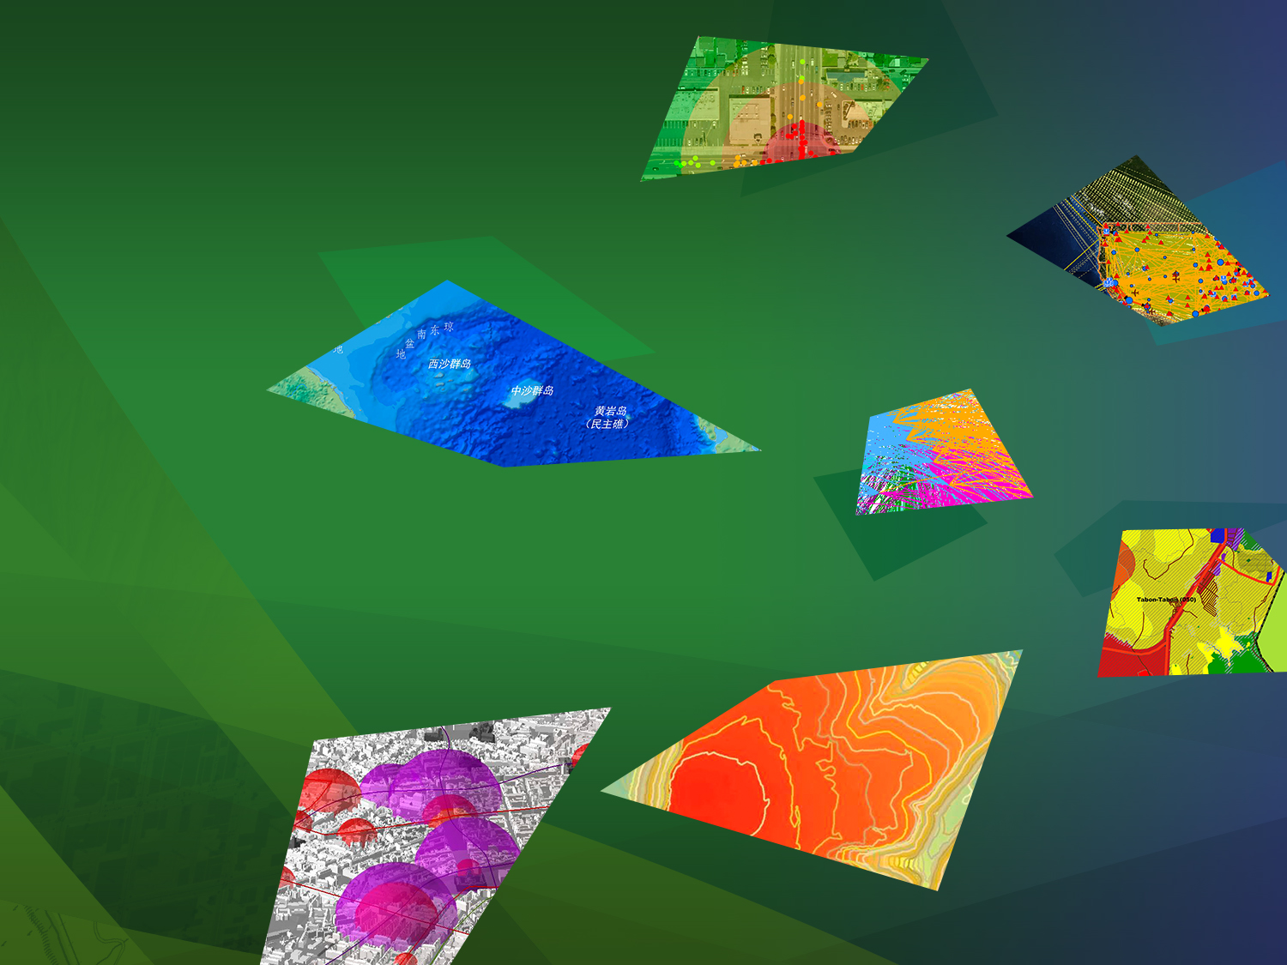
Government
Pollution
Transportation
Social Conflicts
Utilities
Climate Change
Urbanization & Development
Water Resources
Oceans
Mapping
Economic Recovery
Energy
Science & Technology
Nature Conservation
Environment
Natural Disasters
Naš posao…
Education
Agriculture
Human Health
…na malo drugačiji način
Infrastructure
Defense & Security
Business
Population Growth

Slide 11
GIS menja naš način razmišljanja i delovanja
Integracija geografske nauke u svakodnevni posao
Evolucija ka prostornoj inteligenciji
Dizajn
Evaluacija
Planiranje
Odlučivanje
Priprema
Delovanje
Predviđanje
Analiza
Upravljanje
Merenje

Slide 12
GIS alati koji nam pomažu da shvatimo svet:
Integralno
Vizuelno
Kvalitativno
Kvantitativno
Sistematski
Sveobuhvatno
Praktična sredstva za shvatanje našeg sveta
Notes:
GIS is already helping us understand things. It's also providing a framework, a practical means for transforming the world with all kinds of activities. Let's look at its characteristics. It’s integrative, right? It's visual. It's quantitative and analytic. It has the magical properties of organizing things systematically. And also it's built on the science of geography, which is comprehensive. In this respect, it qualifies to really scale up.

Slide 13
Esri ArcGIS alati

Slide 14
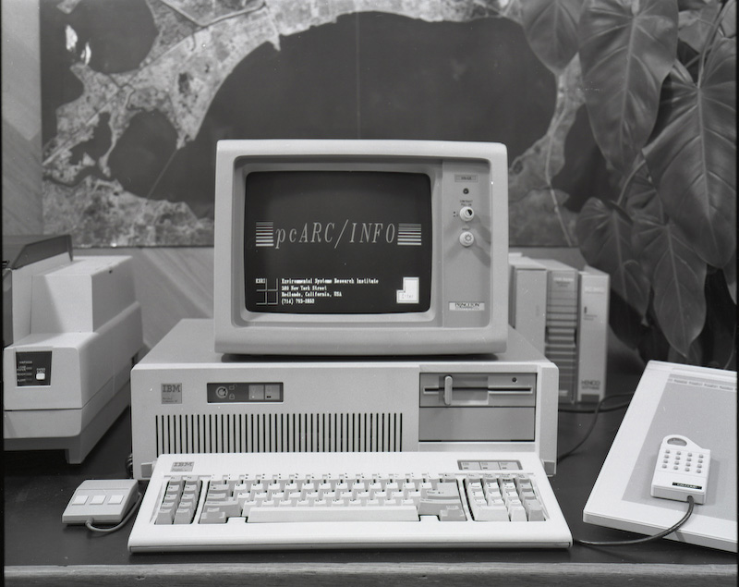
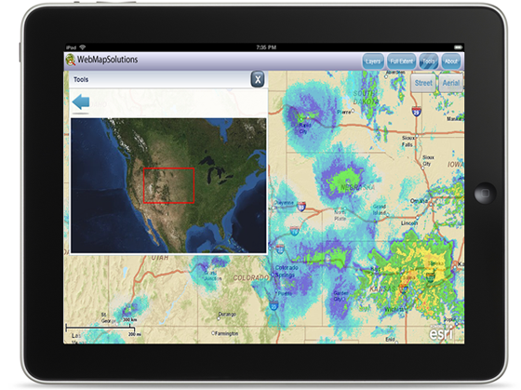
Environmental Systems Research Institute
1969 - …
Pioniri u oblasti primene i razvoja GIS-a
Naučni pristup u primeni i razvoju
Apsolutni lideri u oblasti GIS-a
Apsolutni lideri u sferi obrazovanja u GIS-u

Slide 15
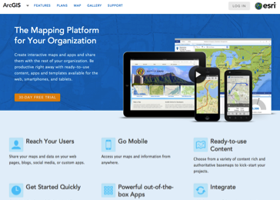
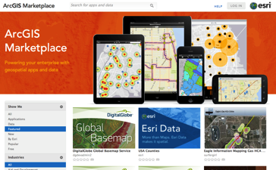
Esri ArcGIS platforma
Platforma, ne softver!
Dostupna uvek i svuda
Desktop
Web
Uređaji
Jednostavnost
Integrisanost
Otvorenost
Kvalitet
Sigurnost
Administracija
Baze podataka
Real Time
Upravljanje sadržajima
Web mape
Aplikacije
Web GIS
Portal
Server
Online Sadržaji i Servisi
Dostupno kroz Cloud ili On-Premises

Slide 16
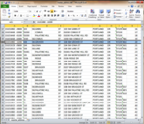
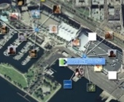
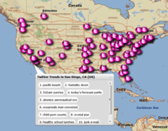
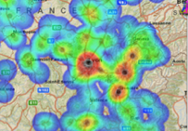
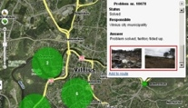
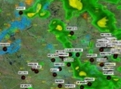
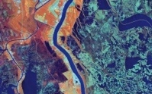
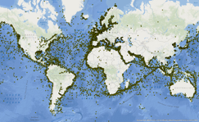
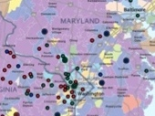
Esri ArcGIS platforma
Platforma koja može integrisati sve
Enterprise Data
Social Media
Services
Web Maps
Imagery
Sensor
Networks
Maps
Big Data

Slide 17
Esri ArcGIS platforma
ArcGIS for Desktop + Extensions: analitika i produktivnost
Esri City Engine
ArcGIS for Server + Extensions: analitika i produktivnost
ArcGIS for Mobile: analitika i produktivnost
ArcGIS Online: sadržaji, analitika i produktivnost
Lokaciona analitika: sadržaji, analitika i produktivnost
Aplikacije i razvoj
Edukacija

Slide 18
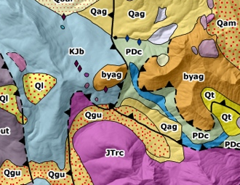
Esri ArcGIS for Desktop
Desktop softver, namenjen GIS profesionalcima;
Prostorne analize;
Upravljanje podacima;
Mapiranje i vizualizacija;
Napredno editovanje;
Geokodiranje;
Deljenje podataka;
Analitičke ekstenzije: 3D Analyst, Spatial Analyst, Geostatistical Analyst, Network Analyst, Schematics, Tracking Analyst, Business Analyst;
Ekstenzije za produktivnost: Data Interoperability, Data Reviewer, Publisher, Workflow Manager, ArcScan, Maplex;
Specijalizovane ekstenzije: Production Mapping, Aviation, Maritime, Defense, Roads

Slide 19
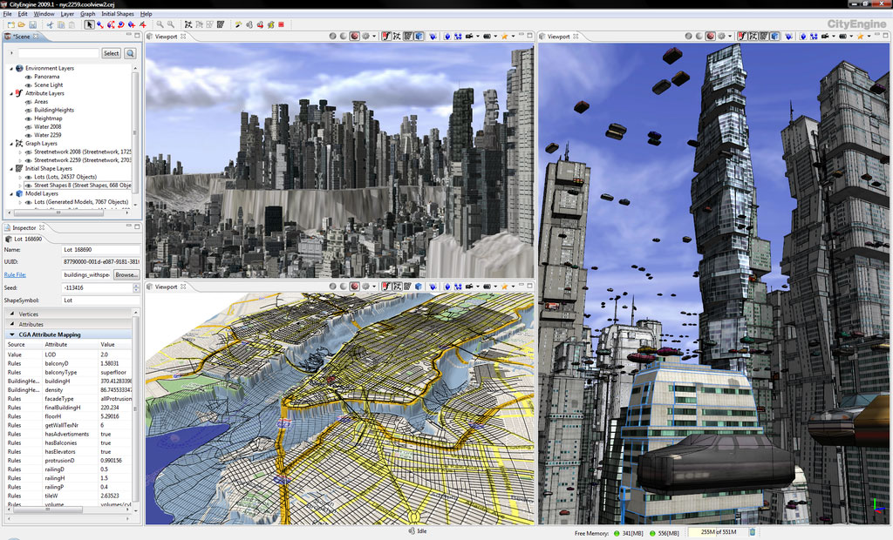
Esri City Engine

Slide 20
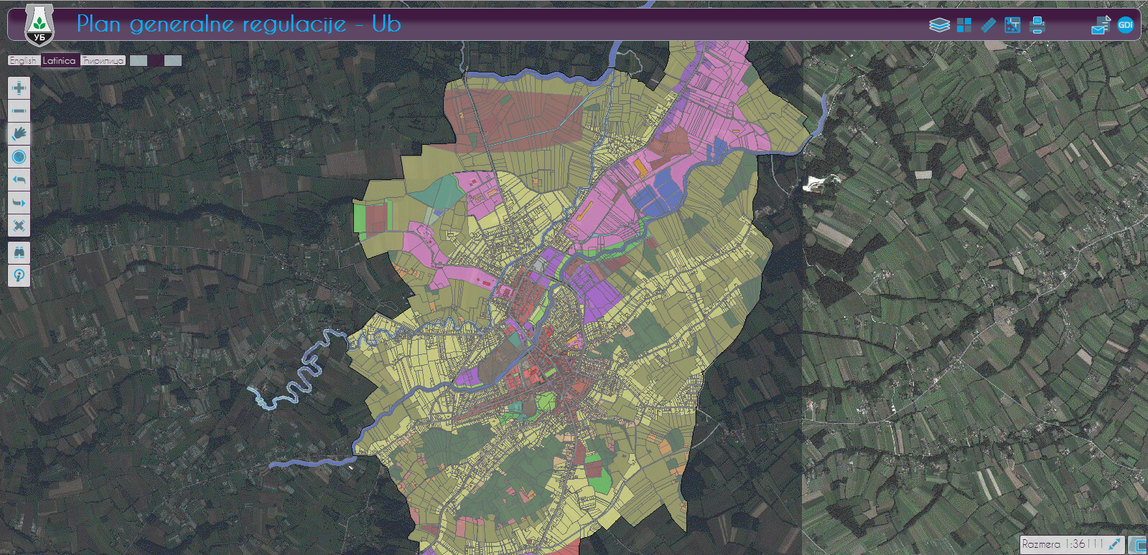
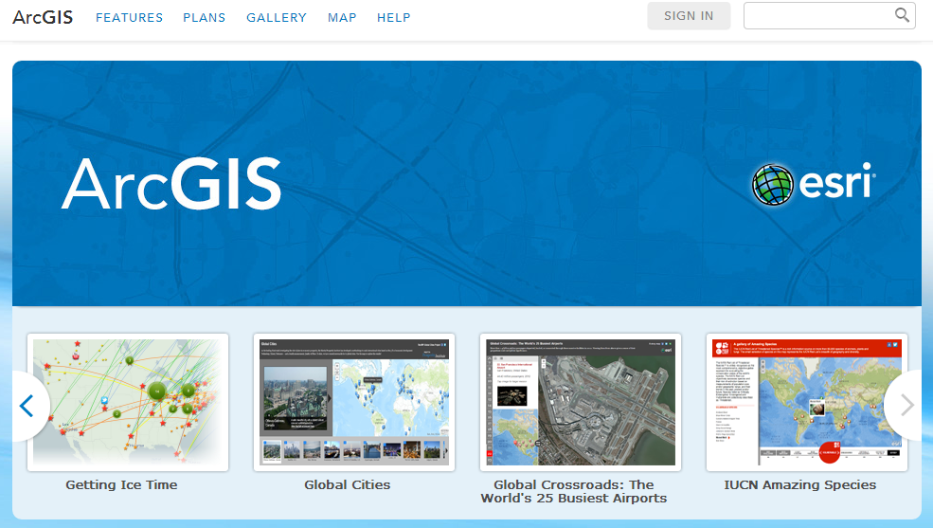
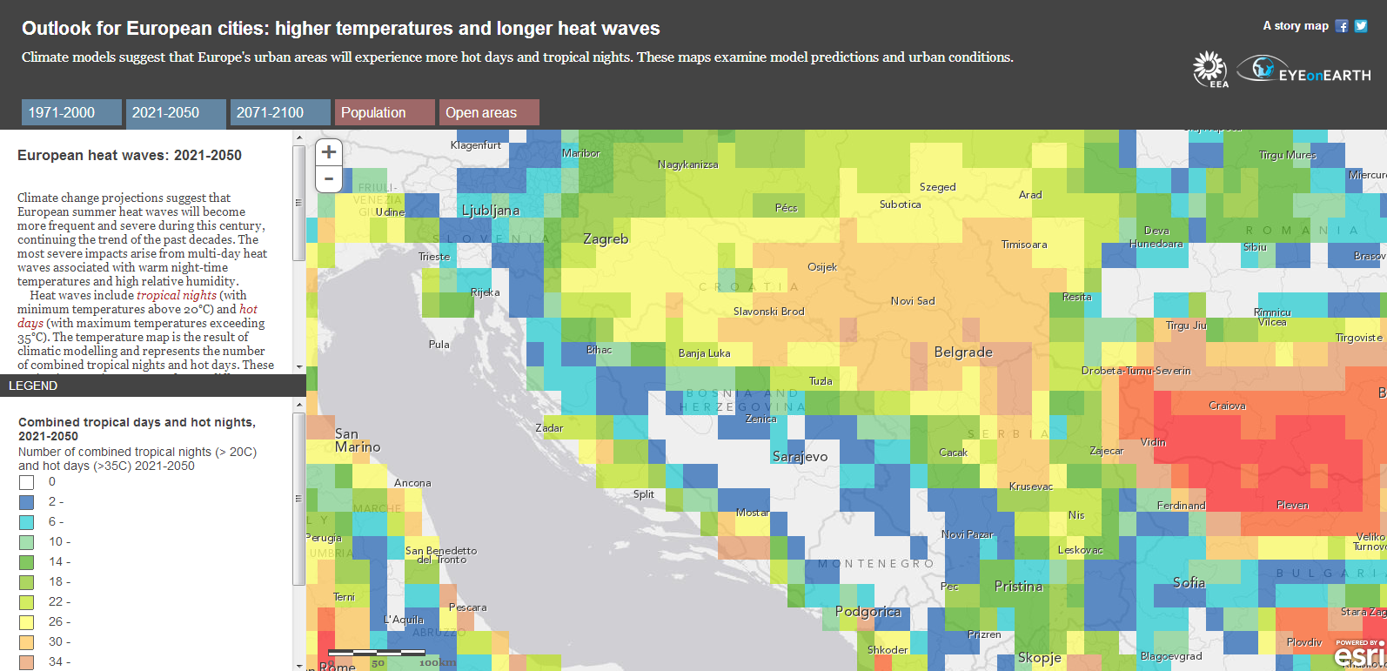
Esri ArcGIS for Server
Web GIS softver, namenjen organizacijama;
Serviranje GIS servisa: mapa, geoobjekata, saobraćajnih mreža, geodata, geoprocesiranja, lokatora, rastera…
Upravljanje geobazama podataka (SQL Server, Oracle, DB2, Informix, Postgre, Natezza, Terradata);
Aplikacije za web mape (JavaScript, Silverlight, Flex)
Podrška za pametne telefone i tablet uređaje (Android, iOS, Windows)
Editovanje preko web-a;
Portal for ArcGIS (Map Centric CMS);
Ekstenzije: 3D Analyst, Spatial Analyst, Network Analyst, Geostatistical Analyst, Schematics, GeoEvent Processor, Data Interoperability, Data Reviewer, Workflow Manager, Image, ArcGIS for INSPIRE, Portal for ArcGIS

Slide 21
Esri ArcGIS for Mobile
Softver za mobilne uređaje, namenjen pojedinačnim korisnicima, profesionalncima i organizacijama;
Aplikacije za pametne telefone i tablet uređaje:
Collector for ArcGIS
ArcGIS for Smartphones and Tablets
ArcGIS for Windows 8
ArcGIS za Windows Mobile
ArcPad

Slide 22
Esri ArcGIS Online
World Imagery Map
World Street Map
World Topo Map
Canvas
Imagery
Basemaps
Landscape Maps
Elevation Services
Esri
Community
Map Data
GeoCoding
Reverse GeoCoding
GeoSearch
Landscape
Analysis
Geocoding
Location
Analysis
Network
Analysis
Demographics in GeoEnrichment
Demographic Maps
Route
Drive time
VRP

Slide 23
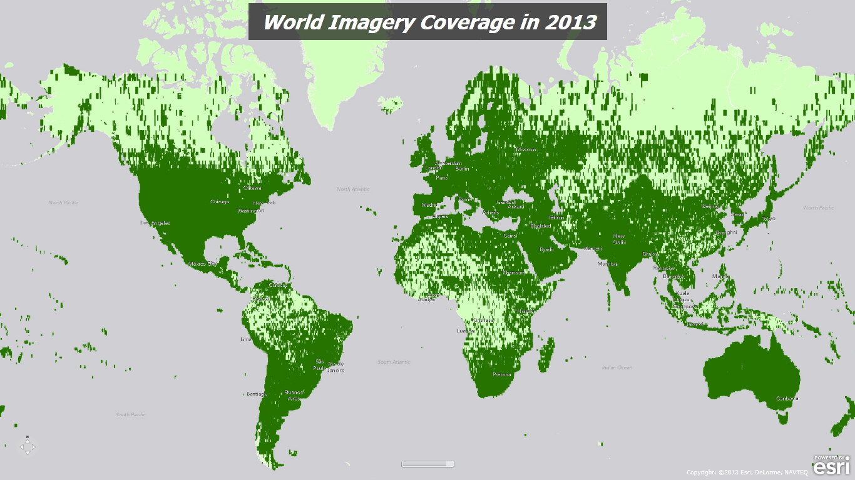
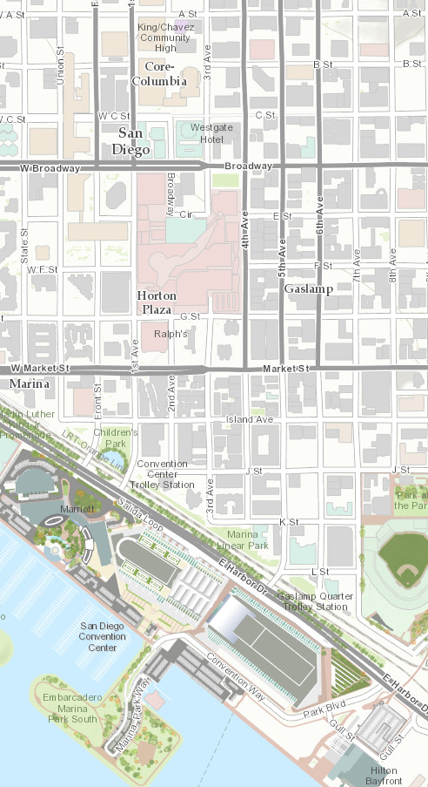
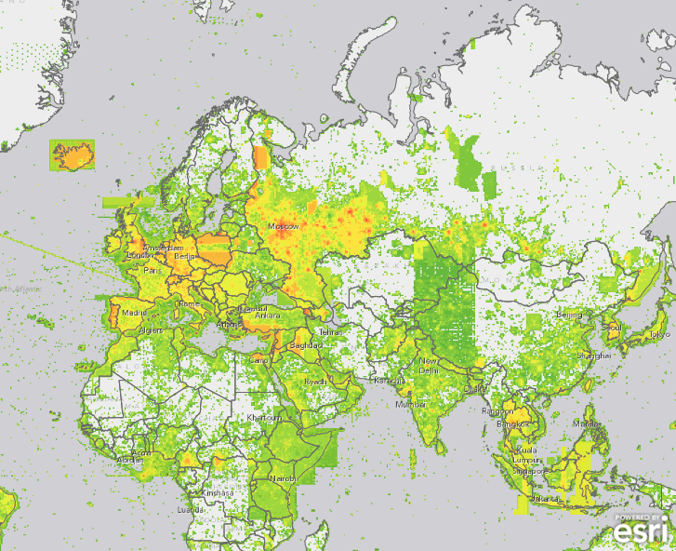
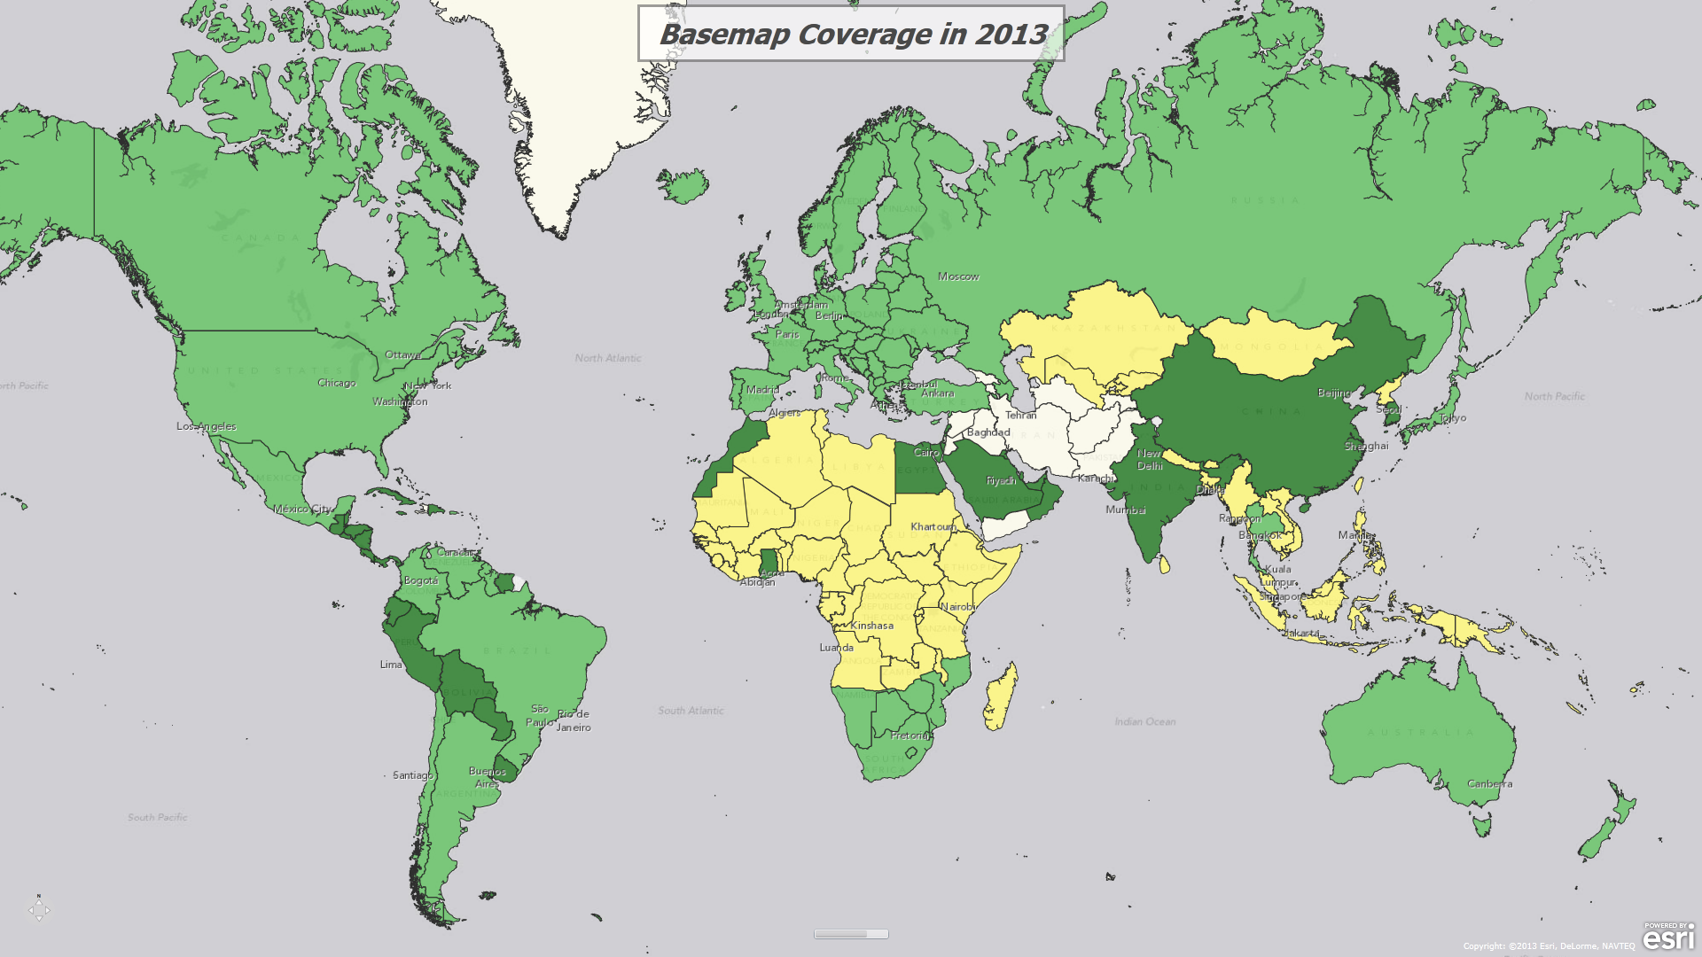
Esri ArcGIS Online

Slide 24
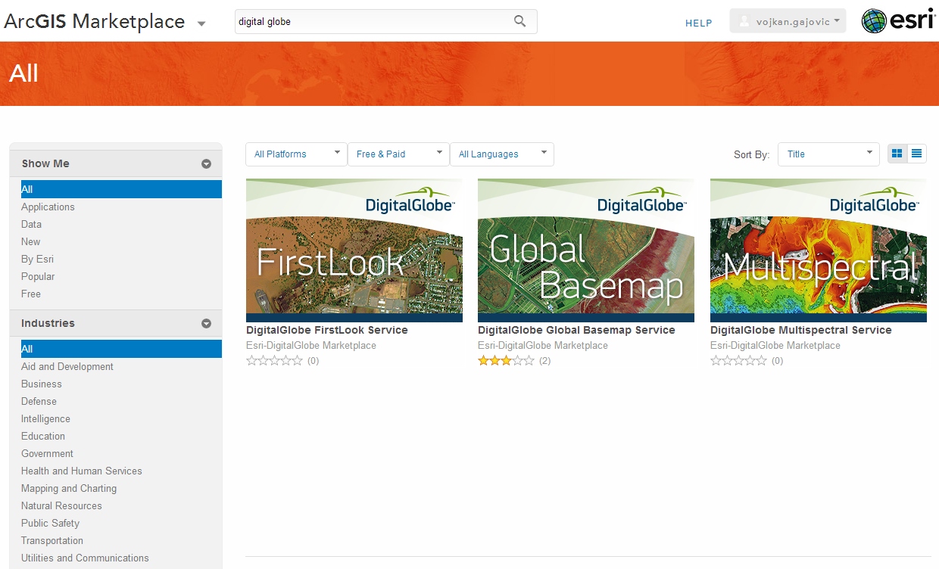
Esri ArcGIS Marketplace

Slide 25
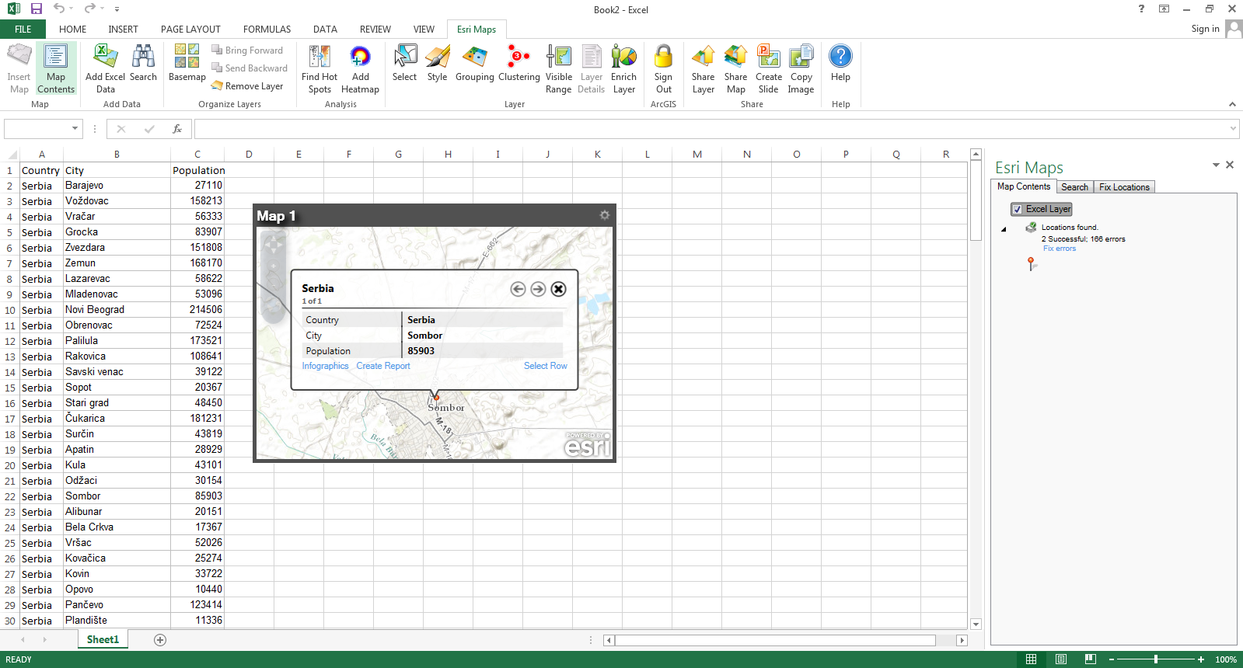
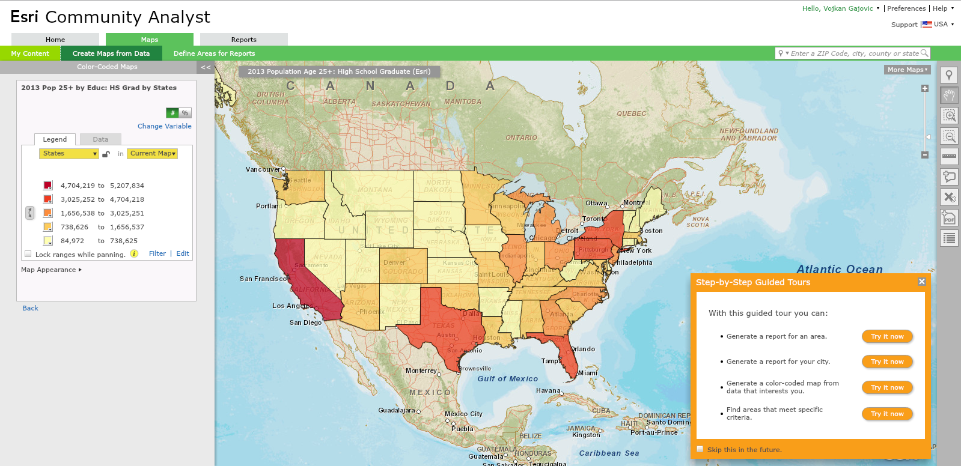
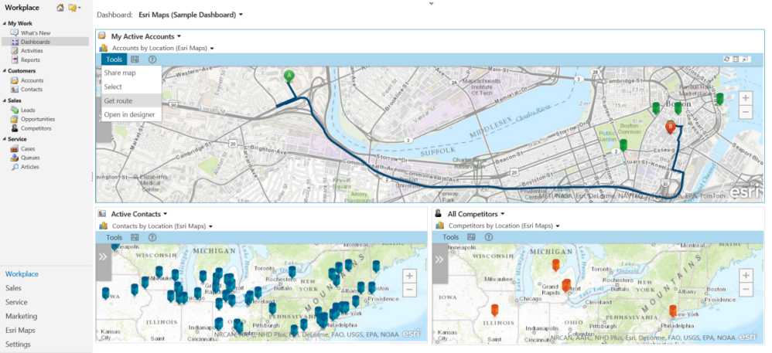
Esri Location Analytics
Esri Maps for Office
Esri Maps for IBM Cognos
Esri Maps for SharePoint
Esri Maps for Dynamics CRM
Esri Maps for MicroStrategy
Esri Business Analyst
Esri Community Analyst

Slide 26
Aplikacije i razvoj

Slide 27
Edukacija
Instruktorski treninzi i radionice
Web kursevi i radionice
Besplatni treninzi i radionice
ArcGIS for Teaching and Researh – za škole, univerzitete i naučne institucije
ArcGIS for Home Use – za samostalno učenje

Slide 28
Exelis ENVI alati

Slide 29
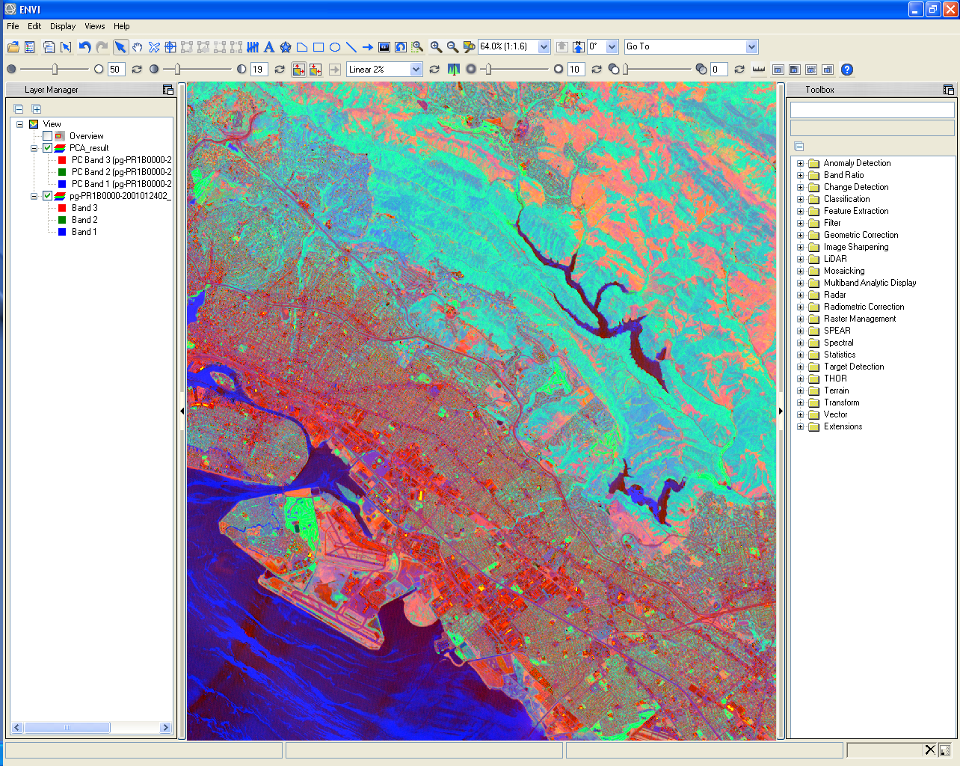
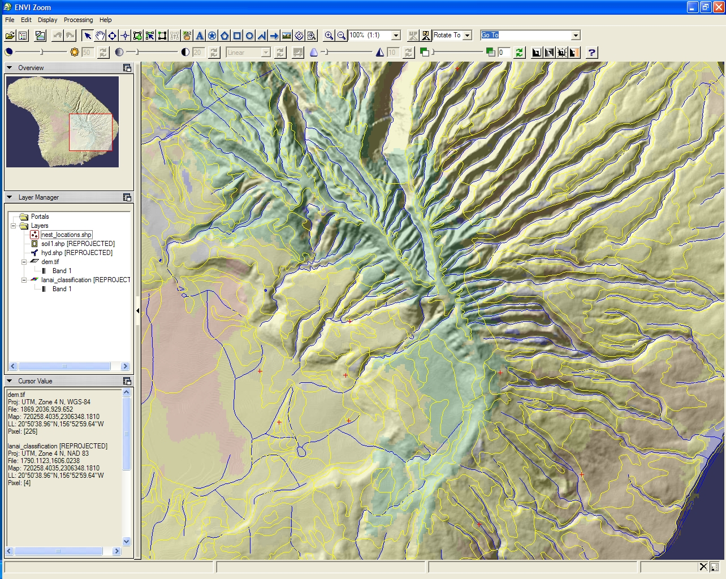
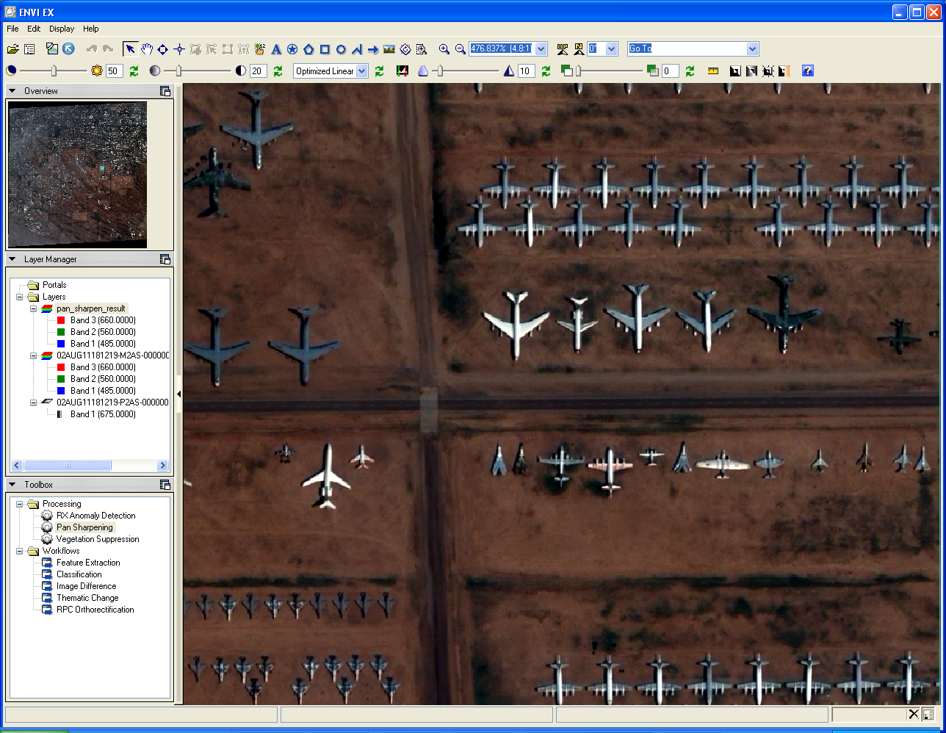
Exelis Visual Informations Solutions
1977 - …
Pioniri u oblasti razvoja naučnog programskog jezika za vizualizaciju podataka (IDL)
Naučni pristup u primeni i razvoju
Jedna od vodećih platformi za spektralnu analizu rastera i rad sa geoprostornim podacima

Slide 30
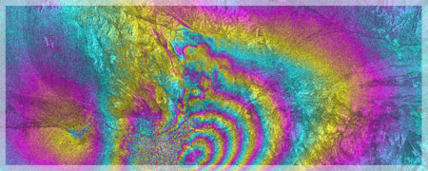
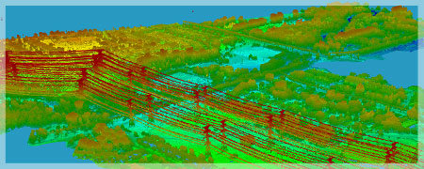
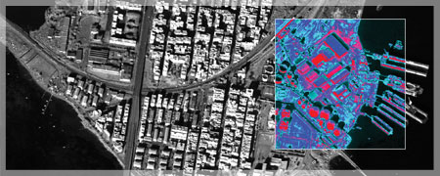
Exelis VIS platforma
ENVI
ENVI Services Engine (cloud)
ENVI LiDAR
ENVI SARscape
ENVI for ArcGIS
IDL

Slide 31
Exelis VIS platforma

Slide 32
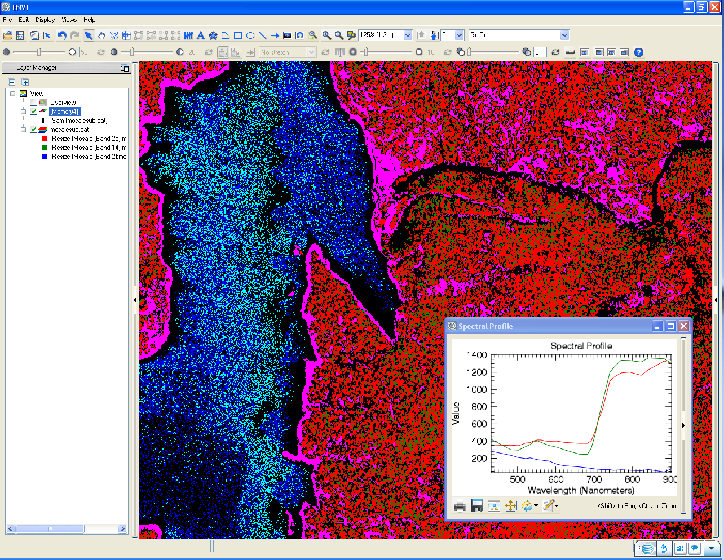
Exelis VIS platforma

Slide 33
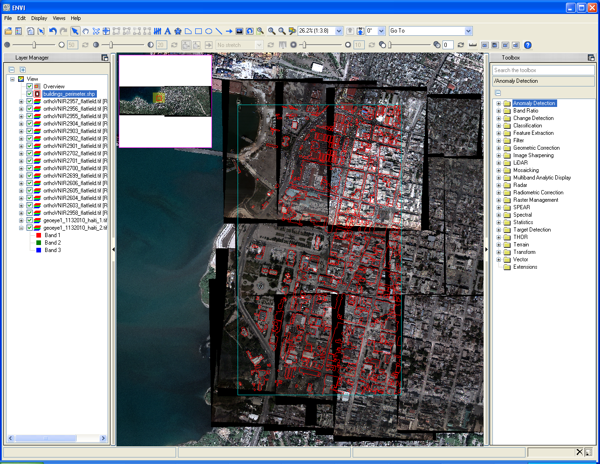
Exelis VIS platforma

Slide 34
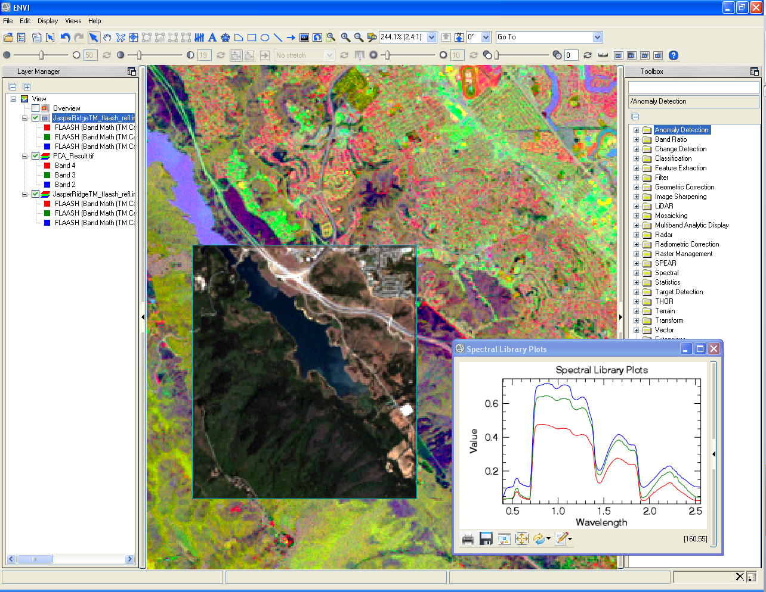
Exelis VIS platforma

Slide 35
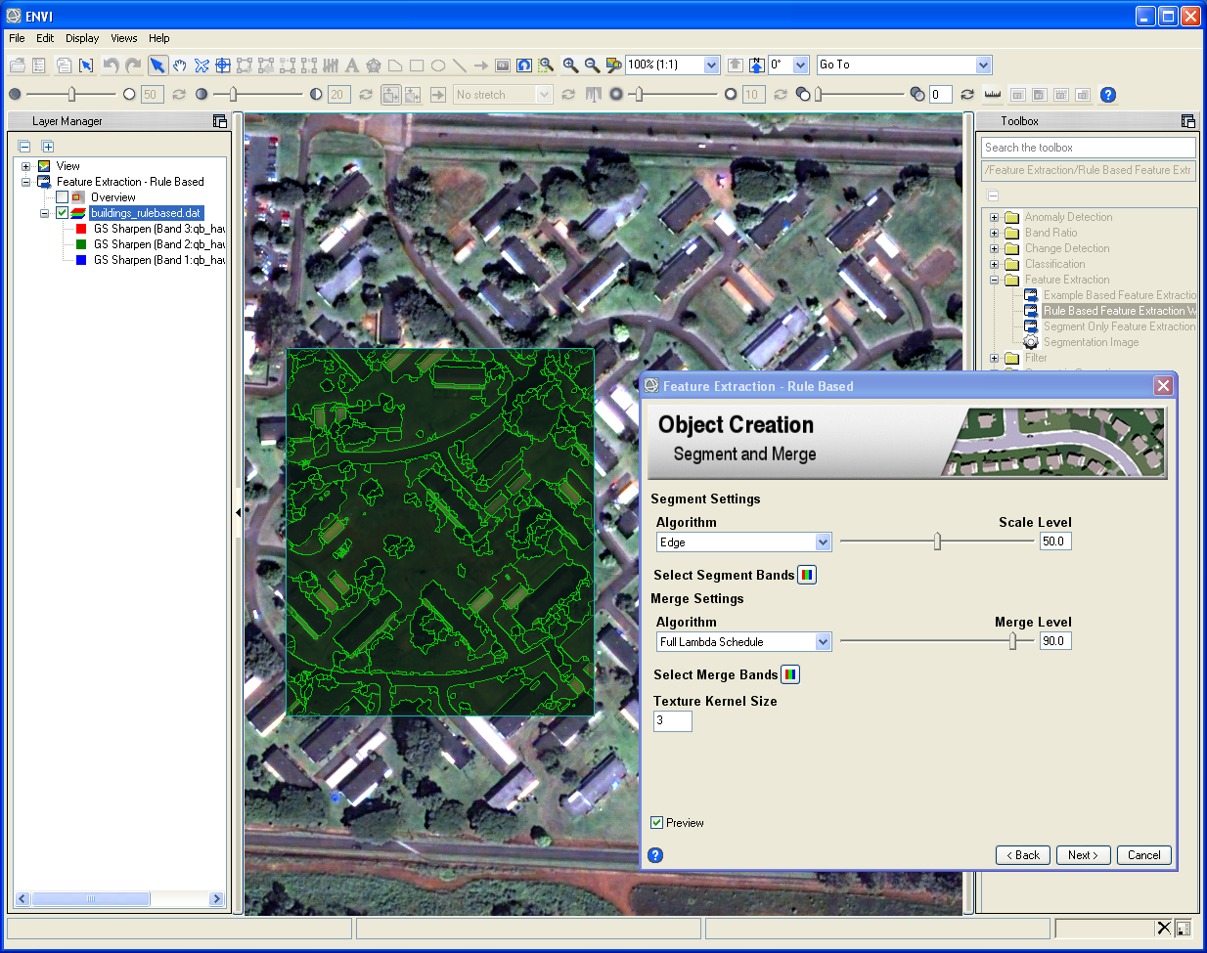
Exelis VIS platforma

Slide 36
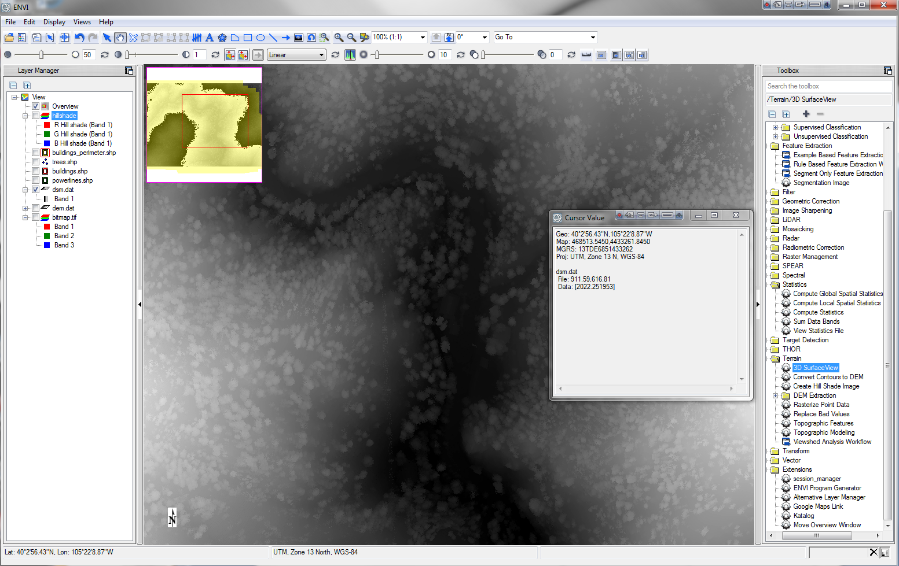
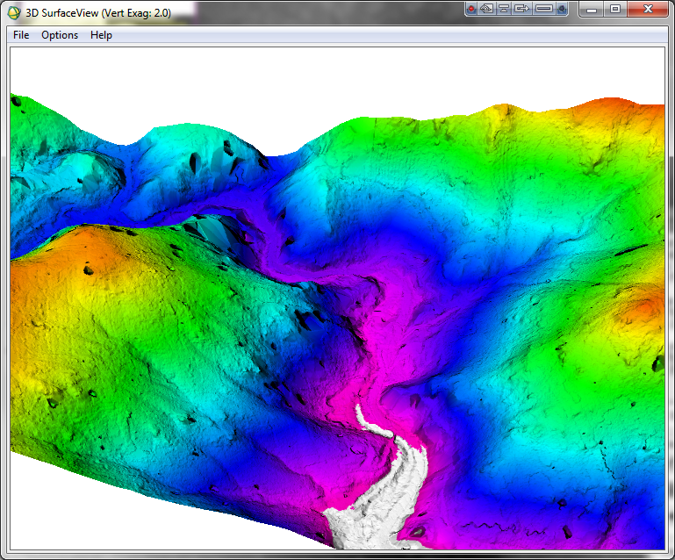
Exelis VIS platforma

Slide 37
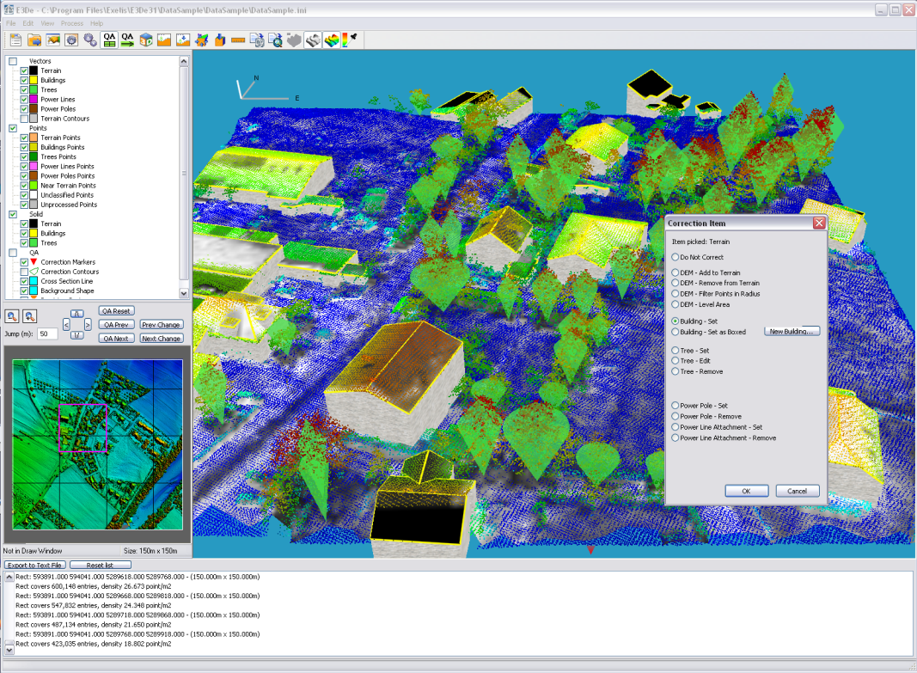
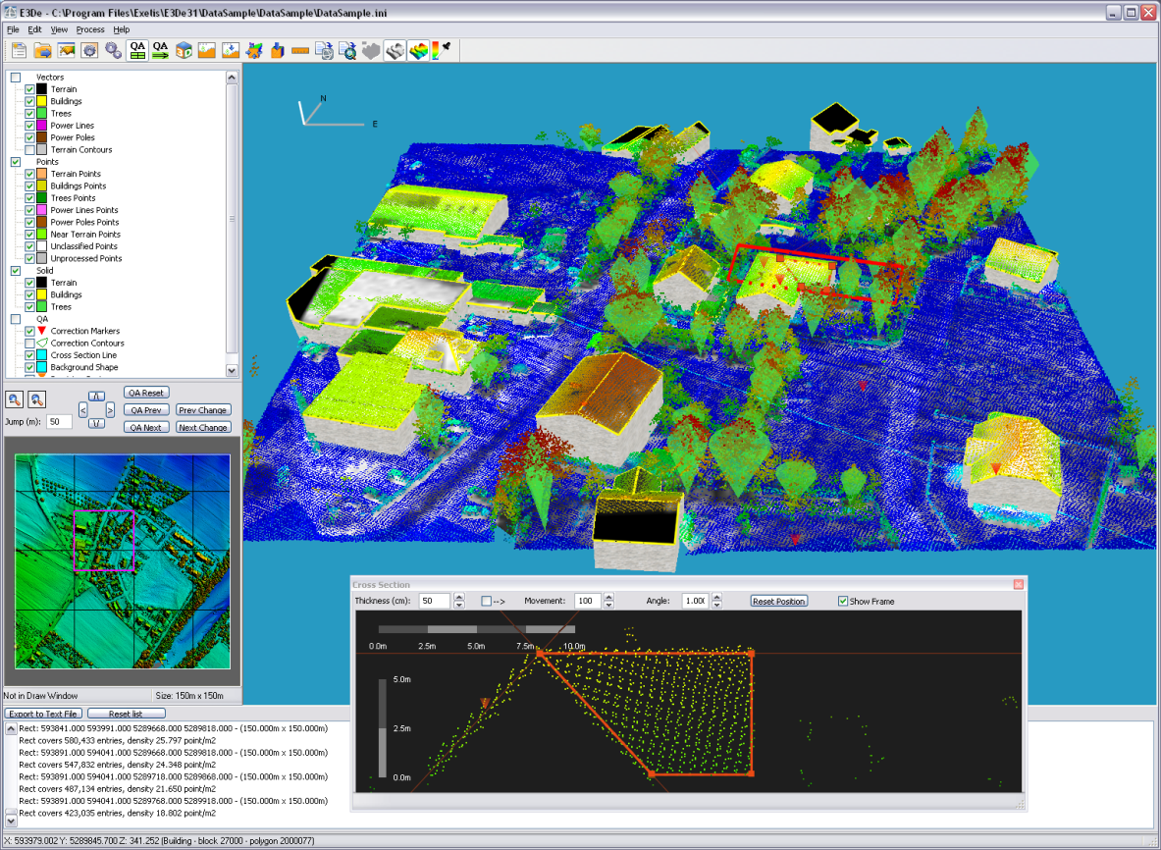
Exelis VIS platforma

Slide 38
Exelis & Esri
Više od partnerstva
Direktna integracija u softverskim rešenjima

Slide 39
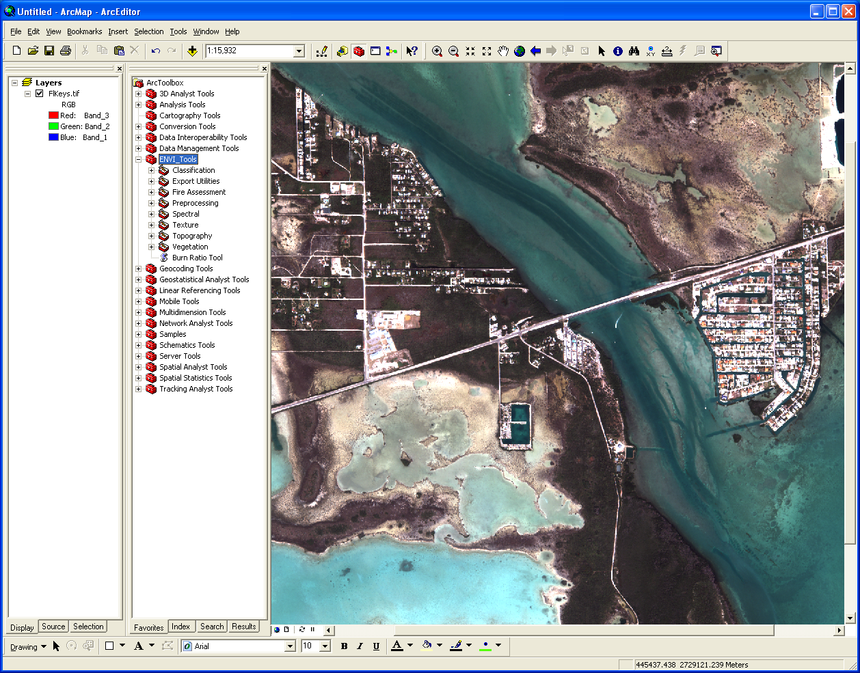
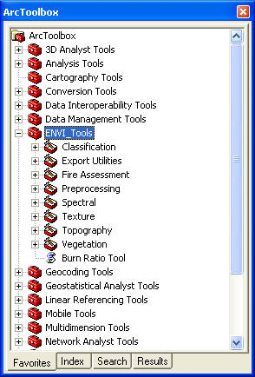
Exelis & Esri
Više od partnerstva
Direktna integracija u softverskim rešenjima ArcGIS for Desktop i ArcGIS for Server, ENVI i ENVI Ex

Slide 40
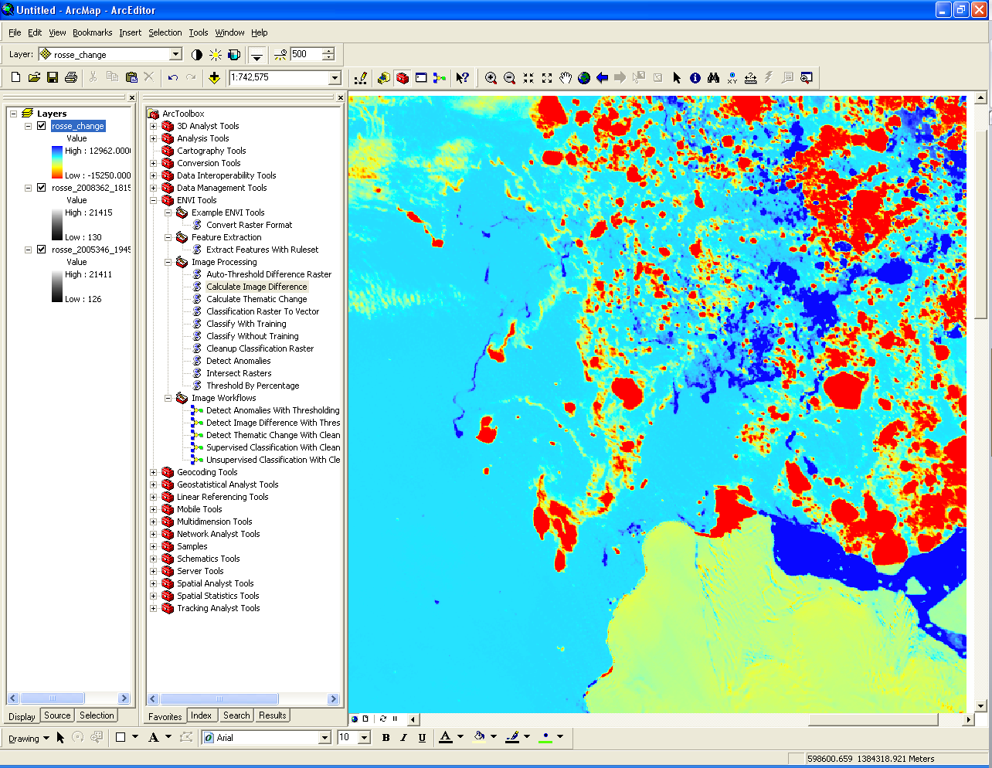
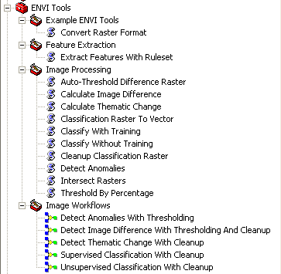
Exelis & Esri
Više od partnerstva
Direktna integracija u softverskim rešenjima ArcGIS for Desktop i ArcGIS for Server, ENVI i ENVI Ex
D

Slide 41
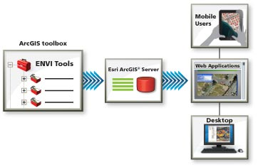
Exelis & Esri
Više od partnerstva
Direktna integracija u softverskim rešenjima ArcGIS for Desktop i ArcGIS for Server, ENVI i ENVI Ex

Slide 42
Understanding and transforming our world!

Slide 43
“Today our world is facing serious challenges, and it’s clear that we need to work together to collectively create a better future. We don’t really have a lot of choice in this matter. We need to leverage our very best brains, our best creative talent, our best design talent, our technology, and our science, and use it to create a more sustainable future. It’s a big challenge–by its very nature, a geographic challenge–that will require a lot of GIS talent. GIS changes how we think and how we act. It’s transformational. It also integrates geographic science into everything we do–what we measure, how we analyze things, what predictions we make, how we plan, how we design, how we evaluate, and ultimately how we manage it over time”
Jack Dangermond

Slide 44
Hvala na pažnji! vojkan.gajovic@gdi.net

